Slide 1
Module 6 Conduct procurement (Part 1)
Mgmt 6063 – Project Procurement

Slide 2

Module agenda
Module Learning Outcomes
Understand use of inputs, tools, techniques in the conduct procurement process
Apply use of different contract types depending on risk and other project details
Calculate contract incentive fees
Homework/evaluations
Notes:
Image https://www.sandler.com
Apply categories .....
Understand the advantages ...
Use of Function Points ...
Work with 3-point estimates,...
Discern the various reasons ...
Calculate ...
Develop ...
Evaluate ...
Extract ...
Recognize ...

Slide 3
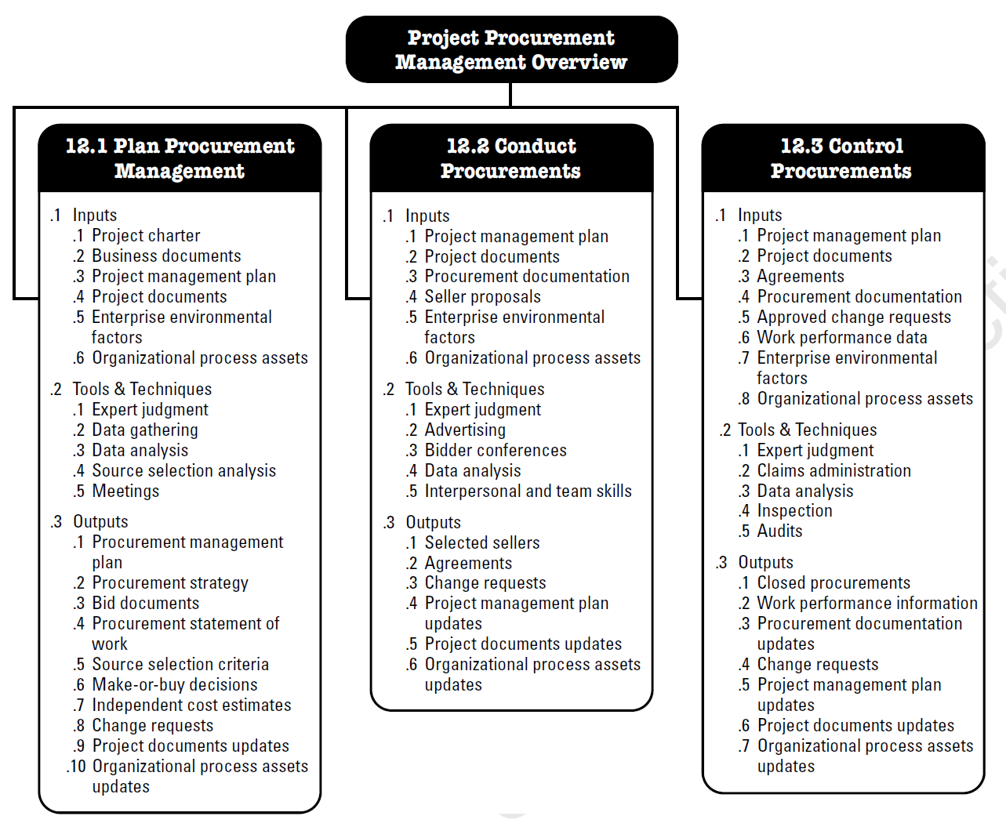
Project procurement management conduct procurement
Conduct Procurement The process of obtaining seller responses, selecting a seller, and awarding a contract. End results: established agreements including formal contracts.
Notes:
Image - Project Management Institute, Inc., PMBOK Guide 6th Edition (2017)

Slide 4
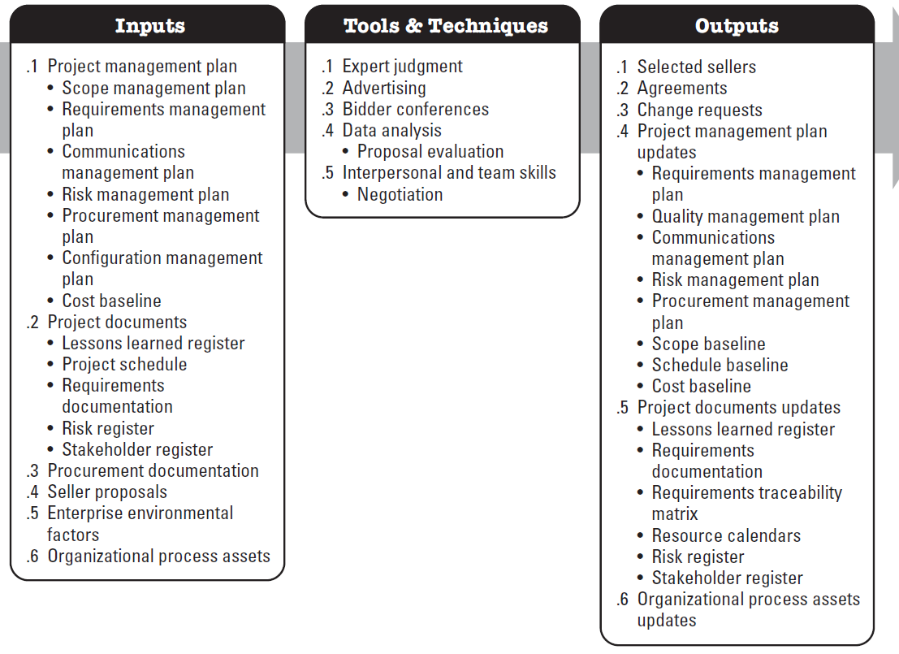
conduct procurement inputs
Notes:
Image - Project Management Institute, Inc., PMBOK Guide 6th Edition (2017)

Slide 5
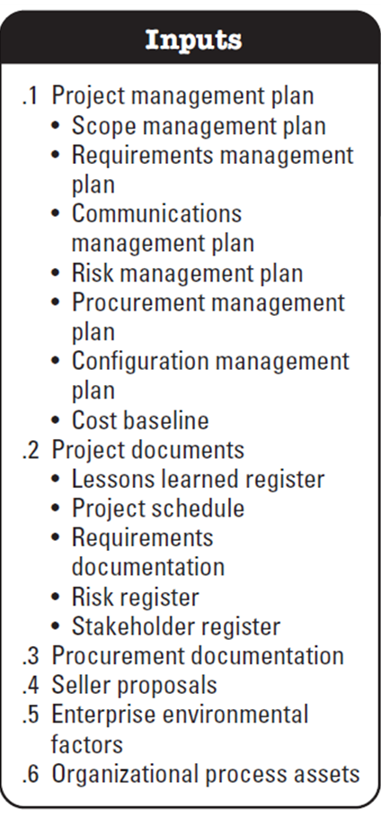
conduct procurement inputs
Configuration Management Plan
Describes how the information about the items of the project (and which items) will be recorded and updated so that the product, service or result of the project remains consistent and/or operative.
Notes:
Image - Project Management Institute, Inc., PMBOK Guide 6th Edition (2017)
Definition Retrieved from https://blog.bit.ai/procurement-management-plan/ on 20210429

Slide 6
conduct procurement inputs
Procurement Documentation
Bid documents
Procurement statement of work
Independent cost estimates
Source selection criteria
Seller proposals
Received from sellers in response to the procurement document package
Notes:
Image - Project Management Institute, Inc., PMBOK Guide 6th Edition (2017)
Definition Retrieved from https://blog.bit.ai/procurement-management-plan/ on 20210429

Slide 7
conduct procurement tools and techniques
Notes:
Image - Project Management Institute, Inc., PMBOK Guide 6th Edition (2017)

Slide 8
conduct procurement tools and techniques
Advertising
Reaching out to potential sellers
Consider: City of London bids webpage, advertising in industry publications, other:
https://canada.constructconnect.com/dcn/canadian-construction-tenders/ontario
Bidder conferences
Meeting between the buyer and prospective sellers prior to proposal submission
Example – next slide
Notes:
Image - Project Management Institute, Inc., PMBOK Guide 6th Edition (2017)
Definition Retrieved from https://blog.bit.ai/procurement-management-plan/ on 20210429

Slide 9
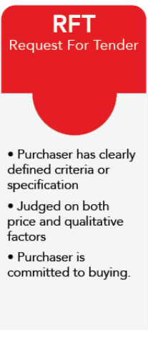

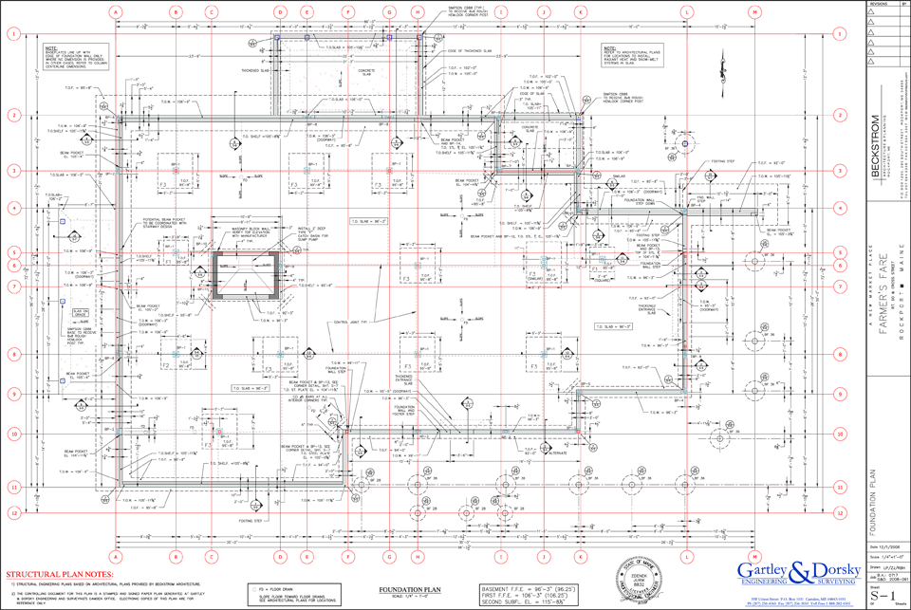
Recall from module 5 request for tender
City posts RFT on their Bids and Tenders webpage
Evaluate bids from contractors
Choose preferred proponent
Contract is executed
Contractor starts project
Bidder conference
The City of London may hold a bidder conference here to answer any questions the potential bidders (sellers) may have about the project.
Why? Value?
The consultant has finished evaluating wastewater treatment options for the City of London, and has completed design of a new wastewater treatment plant. The City needs to find the best contractor to build the new facility
+
x100s

Slide 10
Bidder conferences
Bidder conferences are used so that no single bidder has more knowledge than others.
If a potential bidder has a question concerning the solicitation package, then it must wait for the bidders’ conference to ask the question so that all bidders will be privileged to the same information.
Some companies do not use bidder conferences and allow bidders to send in questions. The answer to each question is provided to all bidders.
Bidder conferences are also held as part of debriefing sessions whereby the bidders are informed as to why they did not win the contract.

Slide 11

conduct procurement tools and techniques
Proposal evaluation
Evaluate in terms of bid document requirements (we will explore in Module 7)
Negotiation
We will explore in Module 10
Notes:
Image - Project Management Institute, Inc., PMBOK Guide 6th Edition (2017)
Image http://osianafitri.blogspot.com/2017/04/what-is-negotiation-rejection-and.html

Slide 12
conduct procurement outputs
Notes:
Image - Project Management Institute, Inc., PMBOK Guide 6th Edition (2017)

Slide 13
conduct procurement outputs
Selected sellers
Woohoo! We’ve decided which seller to use for our procurement needs (we will explore in Module 7)
Agreements
The legal document in place that obligates the seller to provide the specified products, services, or results.
Notes:
Image - Project Management Institute, Inc., PMBOK Guide 6th Edition (2017)
Image http://osianafitri.blogspot.com/2017/04/what-is-negotiation-rejection-and.html
Definition Retrieved from https://blog.bit.ai/procurement-management-plan/ on 20210429

Slide 14

Agreements and contracts
You may recall from other project management courses e.g. MGMT 6054:
Purpose of contract:
Legally binding
Transfer of risk
Mitigate risk
Communicate intent
Terms and conditions
Introduction to main types of contracts:
Fixed price contracts
Cost reimbursable contracts
Time and materials contracts
Notes:
Image justiceeducation.ca

Slide 15
Contractual TERMS Matching game
Handout or Word Doc
Reference: Kerzner p.671 (plus some additional terms) -- matching exercise
See Word doc on FOL called …
M6 Contractual Terms Match Up.docx

Slide 16
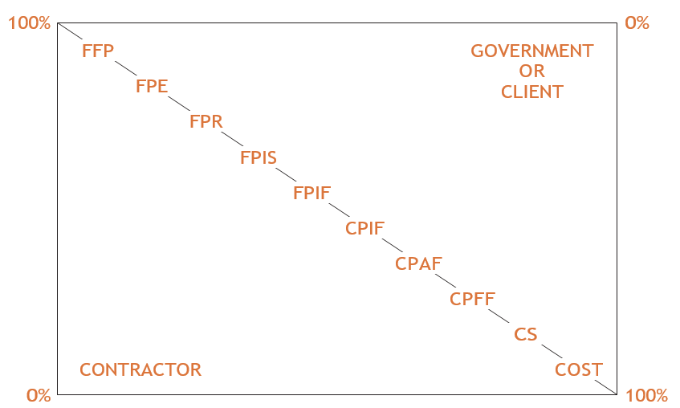
Contracts and risk
Variations of fixed price contracts
Seller/Contractor Risk
Buyer/Owner Risk
Variations of cost-plus contracts
T&M
Interpretation: What does this plot tell us? Which contract type would a buyer/owner want to use to minimize their risk? Which contract type is preferred by the seller/contractor?
Notes:
Image Kerzner – see references slide

Slide 17
Types of contracts
Per listing in PMBOK (Kerzner lists more contract types which may be used in your future workplace):
Contract Types | % Grade | Details
Fixed-price: fixed total price for a defined product, service, or result; used when the requirements are well defined and no significant changes to the scope are expected. | Firm fixed price (FFP) | Price is not subject to change unless the scope of work changes.
 | Fixed price incentive fee (FPIF) | Allows some flexibility in deviation from performance, with financial incentives tied to achieving agreed-upon metrics.
 | Fixed price with economic price adjustments (FPEPA) or sometimes called (FPE) | Used if seller’s performance period spans a considerable period of years, OR if the payments are made in a different currency. A special provision allows for predefined final adjustments to the contract price due to changed conditions (e.g., inflation, cost of commodities)

Slide 18
Types of contracts (cont’d)
Contract Types | % Grade | Details
Cost-reimbursable: involves payments to the seller for all legitimate actual costs incurred for completed work, plus a fee representing seller profit; used if the scope of work is expected to change significantly during the execution of the contract. | Cost plus fixed fee (CPFF) | Seller is reimbursed for all allowable costs for performing the contract work and receives a fixed-fee payment calculated as a percentage of the initial estimated project costs. Fee amounts do not change unless the project scope changes.
 | Cost plus incentive fee (CPIF) | In additional to costs, seller receives a predetermined incentive fee based on achieving certain performance objectives as set forth in the contract.
 | Cost plus award fee (CPAF) | In addition to costs, majority of the fee based on the satisfaction of certain broad subjective performance criteria that are defined and incorporated into the contract.

Slide 19
Types of contracts (cont’d)
Contract Types | Details
Time and Materials (T&M) similar to (T&E) for Time and Expenses | A hybrid type of contractual arrangement with aspects of both cost-reimbursable and fixed price contracts; used when a precise statement of work cannot be quickly prescribed. May specify a maximum contract value. They can grow like cost-reimbursable contracts because the volume of scope/work can increase, but they can act partially like fixed price contracts because some unit rates could be fixed. For example the hourly rate for a software developer cannot increase during the contract, even if the contractor has to end up paying more for the developer who is sub-contracted.

Slide 20
Contract type
Enter the appropriate contract type (see *) and then drag the red framed box or use Slide Show mode
 |  | Contract Type* | Situation
FPEPA | 1. |  | The contract arrangement that is designed to give a seller relief for inflation on a long-term contract.
CPFF | 2. |  | The contract arrangement where the buyer is at the most risk of absorbing excessive cost overruns.
FPIF | 3. |  | The City of London requires construction services for the fully-designed new wastewater treatment plant. There is a firm deadline for completion related to expected population growth.
T&M | 4. |  | Sue Carpenter is offering to install kitchen cabinets for the Smith family at $40/hr and a 10% markup on any purchases made.
*Firm fixed price (FFP), Fixed price incentive fee (FPIF), Fixed price with economic price adjustments (FPEPA), Cost plus fixed fee (CPFF), Cost plus incentive fee (CPIF), Cost plus award fee (CPAF), Time and Materials (T&M)
Notes:
Answers in slideshow mode

Slide 21
Incentive contracts – CPIF
CPIF – Cost Plus Incentive Fee contract
Target cost: $1M
Seller adds 30% ($300K), for a fee/profit
Note, there can be min/max fee limits in CPIF contracts
This becomes a $1.3M quote for the buyer.
If final actual costs are $1M (matches target cost), buyer pays $1.3M
Sharing of incentive between buyer and seller: 80/20 split
If seller is under target cost by $U, (an underage) seller receives $0.20U more (20% of the underage)
If seller is above target cost by $A, (an overage) seller receives $0.20A less (20% of the overage)
See Slide Notes
Notes:
One way of remembering how the 80/20 split works (buyer:seller ratio), is to think of the latter half of the split, the seller “20”, as the % adjustment to what the buyer pays the supplier after the actual cost and fees are totaled. So in the example you can look at it as in both scenarios the supplier was paid the actual costs plus their fee, but if there was an underage they received a bonus fee of 20% of the underage, and if there was an overage, they had a “penalty” fee of 20% of the overage. Note, we can think of this as a penalty, but the supplier might not have done anything “wrong” per se.

Slide 22
Incentive contracts – CPIF (cont’D)
If actual cost is $900K (a $100K underage), buyer saves 80% of underage ($80K), supplier receives 20% of underage ($20K).
Buyer pays supplier $900K+$300K+$20K = $1,220K. The $20K is the incentive fee for the seller performing under target cost.
*Or another approach, buyer pays target cost $1M, plus the $300K fee, but saves 80% of the $100K underage ($80). $1M + $300K - $80K =$1,220K
If actual cost is $1.1M (a $100K overage), buyer pays 80% of overage ($80K), supplier pays 20% of overage ($20K).
Buyer pays Supplier $1,100K+300K - $20K= $1,380K. The $20K is the disincentive fee for the seller performing above target cost.
*Or another approach, buyer pays target cost $1M, plus the $300K fee, but has to pay 80% of the $100K overage ($80). $1M + $300K + $80K = $1,380K
Note, the - $20K is a reduction in the seller’s fee. If the contract had a minimum seller fee, the overage and subsequent reduction of the seller fee could become so big that the minimum fee is applied.

Slide 23
Combinations and variations of contract types
There are numerous approaches to contracts
For example a FPIF contract could basically be a FFP contract with a very simple incentive fee of a $5K penalty for each date the project is late, and $5K bonus for each day early
A contract might have multiple incentive fee components, using measurements such as cost, schedule, quality and even volume of work accomplished
Contracts can be a combinations of contract types, a FFP for most of the project where the scope is well defined and a T&M where the scope has yet to be defined
Contracts can change while the project is underway if both parties agree -- via addendums or other documents that modify the contract

Slide 24
Incentive contracts - FPIF
FPIF – Fixed Price Incentive Fee contract
Buyer’s ceiling price (the most they will pay): $11,500
Target cost: $10,000
Profit to be made by seller if project is completed at target cost: $850
Target price = Target cost plus profit or $10,000 + $850 = $10,850
Sharing of incentive between buyer and seller: 70/30
If seller is under target cost by $U, (an underage) seller receives $0.30U more (30% of the underage)
If seller is above target cost by $A, (an overage) seller receives $0.30A less (30% of the overage)
If actual cost is $9,000 (a $1,000 underage), the buyer saves 70% of the underage ($700), supplier receives 30% of the underage ($300).
Buyer pays supplier $9000+$850+$300 = $10,150.

Slide 25
Incentive contracts – FPIF (cont’d)
If actual cost is $11,000 (a $1,000 overage). Without a ceiling price, buyer pays 70% of the overage ($700) and the supplier has to pay 30% of the overage ($300). The buyer would pay seller $11,000 + $850 - $300 = $11,550, but this exceeds the $11,500 ceiling price
There is an overage amount where the buyer stops paying 70% of the overage and the seller starts paying 100% of the overage. This PTA Point of Total Assumption is a calculated Actual Cost as follows: Target Cost + (Price Ceiling – Target Price) / Buyer’s Share Ratio or 10,000 + (11,500 – 10,850) / 70% = $10,928
So if the Actual Cost matched the PTA amount of $10,928, the buyer pays Actual Cost plus seller profit, less disincentive fee of 928 * 30% = $278. Buyer pays $10,928 + $850 – $278 = $11,500 (the ceiling price)
In this example, Actual Cost of $11,000 exceeds the PTA so seller also pays 100% of $11,000 - $10,928 = $72. The seller’s profit is $850 - $278 - $72 = $500. Or $11,500 ceiling less $11,000 cost = $500 profit

Slide 26
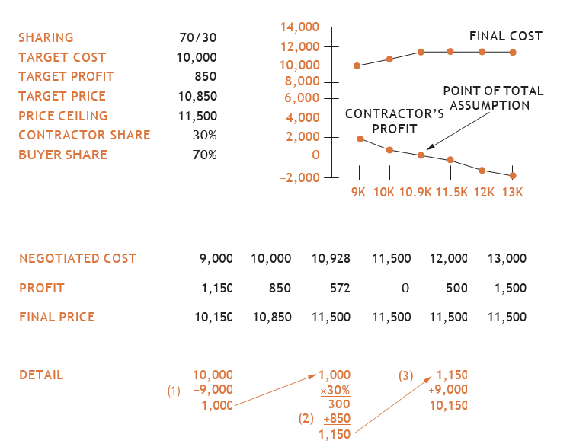
Incentive contract FPIF (cont’d)
Point of Total Assumption - the point at which any additional costs are 100% paid for by the contractor --there is no more splitting of the costs between the buyer and the seller
See Slide Notes
Notes:
Point of Total Assumption (PTA) – the point at which any additional costs are 100% paid for by the contractor (the share incentive split such as 70/30, is no longer applicable).
PTA = Target Cost + (Price Ceiling – Target Price) / Buyer’s Share Ratio
PTA = 10,000 + (11,500 - 10,850)/0.7 = 10,000 + 650/0.7 = 10,000 + 928.6 ~ 10,928.
Image – Kerzner….see references slide

Slide 27
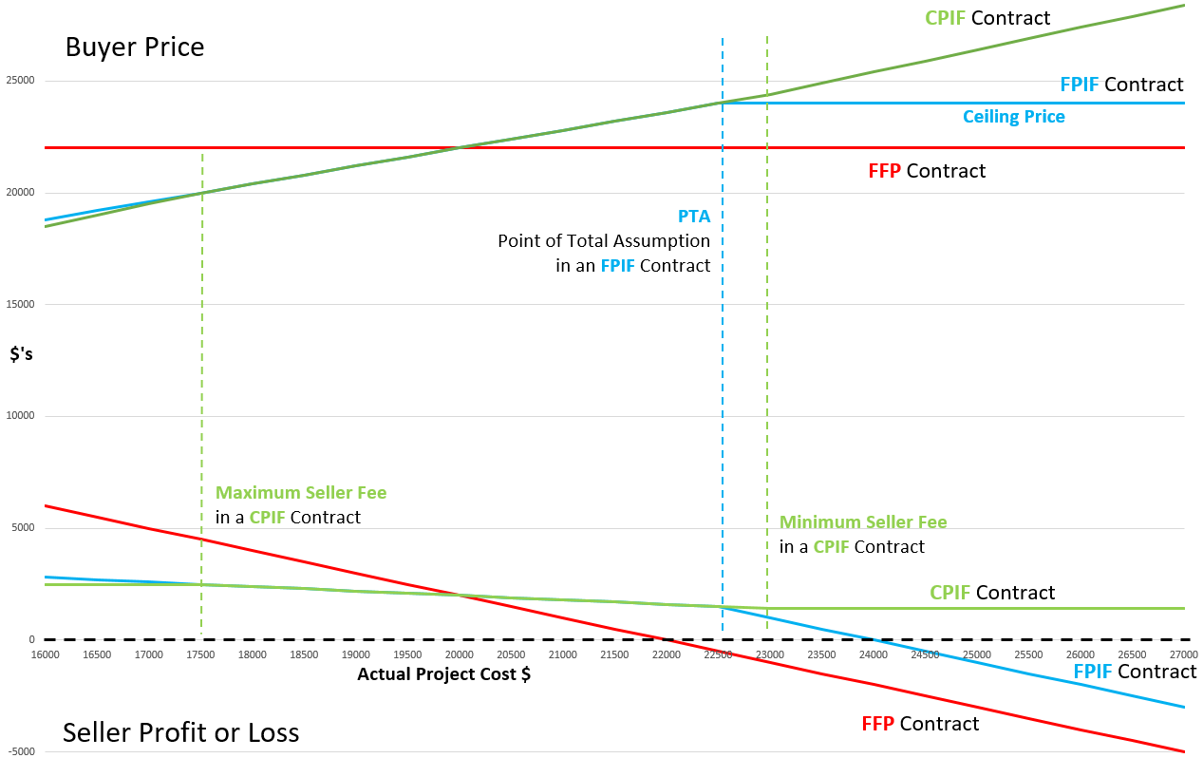
Comparison of contract types
The 3 coloured lines are 3 different types of contract payment, the amount the buyer pays the seller.
The dashed X axis line is the actual cost when the project is complete
See Slide Notes
Notes:
Use this chart to gain an appreciation of the complexity of contracts and the risk vs reward
Note anything below the horizontal dashed line is a loss for the seller.
The horizontal X axis (Actual Project Cost), is the final actual cost (not budgeted cost) of the project
In an FFP contract (red line), note how the seller can have a large profit or a large loss. This is classic risk vs reward with the seller taking most of the risk.
In an FPIF (blue line) the seller may have a more modest profit with a lower loss, but can still have a substantial loss.
In this particular example, if a seller moves from a FFP to a FPIF contract, the seller may be losing a large upside on profit for a smaller decline on loss.
Note that the FFP is a fixed priced contract (horizontal line) from the buyer’s perspective, but the FPIF only starts to look like a fixed price contract (horizontal line)when the ceiling price takes effect.
In this CPIF there is a “Minimum Seller Fee” so the seller is assured they won’t lose money. This may encourage seller’s to bid for a contract with a lower fee as they know they can’t lose money on the project.
At the left hand end of the CPIF and FPIF curves you can see a divergence, this is because there is a maximum seller fee in the CPIF.

Slide 28
Incentive contract exercise
A cost-plus-incentive-fee contract has the following characteristics:
Sharing ratio (buyer : seller): 80:20 (buyer value always placed first)
Target cost: $100,000
Target fee: $12,000
Maximum fee: $14,000 (that can be earned by seller)
Minimum fee: $9,000
How much will the seller be reimbursed if the cost of performing the work is $95,000?
First, calculate incentive fee
= ((target cost – actual cost) x seller’s sharing ratio) + target fee
= ((100,000-95,000) x 0.20) + 12,000
= 5,000 x 0.20 + 12,000
= 1,000 + 12,000
= $13,000
Final reimbursed fee/cost = actual cost + incentive fee
= 95,000 + 13,000 = $108,000
Perform the above exercise first, and then you can
drag this red framed box aside to reveal a solution

Slide 29
Incentive contract exercise
A cost-plus-incentive-fee contract has the following characteristics:
Sharing ratio (buyer : seller): 80:20 (buyer value always placed first)
Target cost: $100,000
Target fee: $12,000
Maximum fee: $14,000 (that can be earned by seller)
Minimum fee: $9,000
Using the same data (above), what will be the reimbursement to the seller if the cost of performing the work is $120,000?
First, calculate incentive fee
= ((target cost – actual cost) x seller’s sharing ratio) + target fee
= ((100,000-120,000) x 0.20) + 12,000
= -20,000 x 0.20 + 12,000
= -4,000 + 12,000
= $8,000
Final reimbursed fee/cost = actual cost + incentive fee (BUT minimum fee is $9,000)
= 120,000 + 9,000 = $129,000

Slide 30
Incentive contracts Exercise
Handout or Word doc
Perform the Incentive Contract exercises …
See Word doc on FOL called …
M6 - Incentive Contract Exercise.docx

Slide 31
Summary of our journey today
Inputs, tools, techniques in the conduct procurement process
Different contract types depending on risk and project details
Contract incentive fees
We will explore other aspects of the conduct procurement process in the next module

Slide 32
Homework and evaluations
Readings for next module as listed in Course Overview
Start preparing for midterm exam

Slide 33
references
Project Management Institute (2017). A Guide to the Project Management Body of Knowledge (Sixth Edition).
Kerzner, Harold (2017). Project Management, Twelfth Edition.
Watts, A. (2014). Project Management. Victoria, B.C.:BCcampus. Retrieved from https://opentextbc.ca/projectmanagement/.

